Slide 1
Good morning my dear students.

Slide 2

Conducted by-
Md Hasan Hafizur Rahman
Lecturer, English
Cambrian School & College, Campus-05, Dhaka.
Class-8
English First Paper
Writing Part

Slide 3
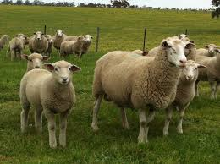
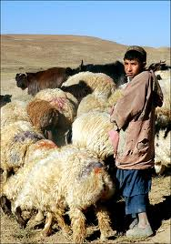
Sheep
Shepherd

Slide 4
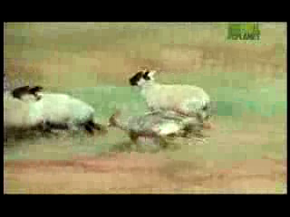
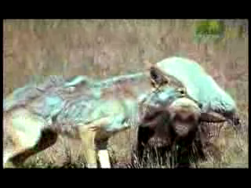

Slide 5
Our Today’s Lesson is-
A Story
“Nobody Trusts a Liar”

Slide 6
Learning Outcomes
After we have studied this lesson we will be able to-
tell about the story
be experienced to tell the truth
ask and answer questions
write a story.

Slide 7
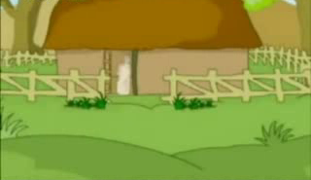
Once upon a time there lived a shepherd in a village near a forest.

Slide 8
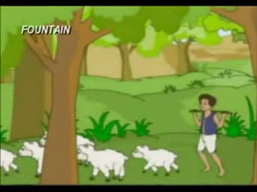
Almost all the day he grazed his sheep on the plain grassy field near the forest.

Slide 9

But he was a naughty boy. He got pleasure in making fun with the villagers.

Slide 10
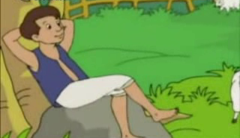
One day while grazing the sheep, he hit upon a plan to make the villagers fool.

Slide 11
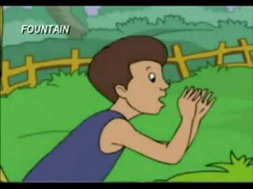
Accordingly, he started shouting, “Help! Wolf! Wolf!”

Slide 12
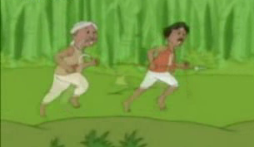
Hearing the shouts, the villagers rushed to rescue him.

Slide 13

But the boy burst into laughter.

Slide 14
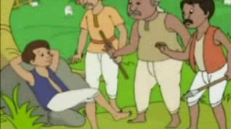
He told them that it was a great fun to make them fool.

Slide 15
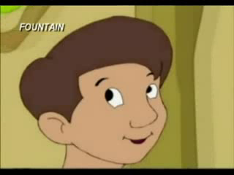
In this way he made fun for several days.

Slide 16
One day as usual he was tending
his sheep near the same forest.

Slide 17
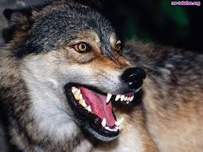
Suddenly a wolf came. The boy cried out for help at the top of his voice.

Slide 18
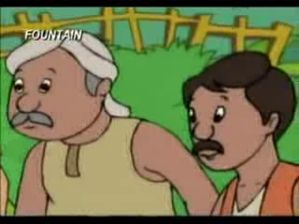
But the villagers thought it to be his
regular fun.

Slide 19
So nobody came to help him, the wolf attacked his sheep

Slide 20
and
killed.

Slide 21
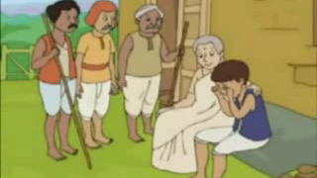
This was the penalty of his telling lies. So we should always speak the truth.

Slide 22
Group Work

Slide 23
Evaluation
Who is a shepherd boy?
Where did he tend sheep?
What did he feel interest with?
What did he do to make fun?
What did the villagers do?
What was the penalty of telling lies?

Slide 24
Home Work
Complete the following incomplete story-
Once upon a time there lived a shepherd in a village near a forest. Almost all the day he grazed his sheep on the plain grassy field.......................

Slide 25
Verse
To tell a lie is great sin.

Slide 26
Thank You

Slide 27
A Liar shepherd Boy
Once upon a time there lived a shepherd in a village near a forest. Almost all the day he grazed his sheep on the plain grassy field near the forest. But he was a naughty boy. He got pleasure in making fun with the villagers. One day while grazing the sheep, he hit upon a plan to make the villagers fool. Accordingly, he started shouting, “Help! Wolf! Wolf!” Hearing the shouts, the villagers rushed to rescue him. But the boy burst into laughter. He told them that it was a great fun to make them fool. In this way he made fun for several days. One day as usual he was tending his sheep near the same forest. Suddenly a wolf came. The boy cried out for help at the top of his voice. But the villagers thought it to be his regular fun. So nobody came to help him the wolf attacked him and killed him. This was the penalty of his telling lies. So we should always speak the truth.

